Slide 1




AgroCentre Website
By
TYIT_11_Burhanuddin Dilshad
TYIT_16_Viraj Gholap
Guided by :
Dr. Mansingh Rathod

Slide 2
Problem Statement :-
To build a platform which would support and promote agribusiness, where farmers could get their agricultural requirements fulfilled and would provide employment opportunities to Agricultural Graduates, Agricultural Diploma holders, Intermediate in Agriculture and Science Graduates in Agri related subjects.

Slide 3
Objective of the project :-
For income generation & entrepreneurship development among unemployed Agricultural Graduates
To support agriculture development.
It enables farmers to purchase tools , seeds & fertilizers directly from vendor.
To help farmers by providing all kinds agriculture related information in the website.

Slide 4




Technology used :

Slide 5
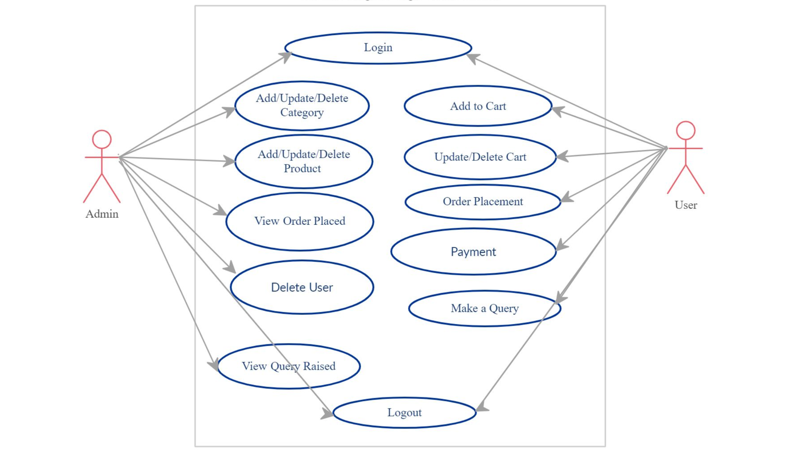
Use case Diagram :

Slide 6




Features :
Video Tutorial Section
Payment Gateway
Shiprocket Shipping API
Email ID OTP Verification
Mobile OTP Verification
Forgot password
Change password

Slide 7
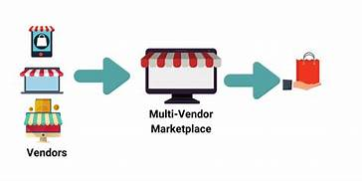


Future Scope :-
Convert to Multi Vendor Marketplace
Add Discussion forum

Slide 8
Conclusion :-
This platform will help Agricultural Graduates to start their startup and also it will support agriculture development.

Slide 9
Thank you..

